Slide 1
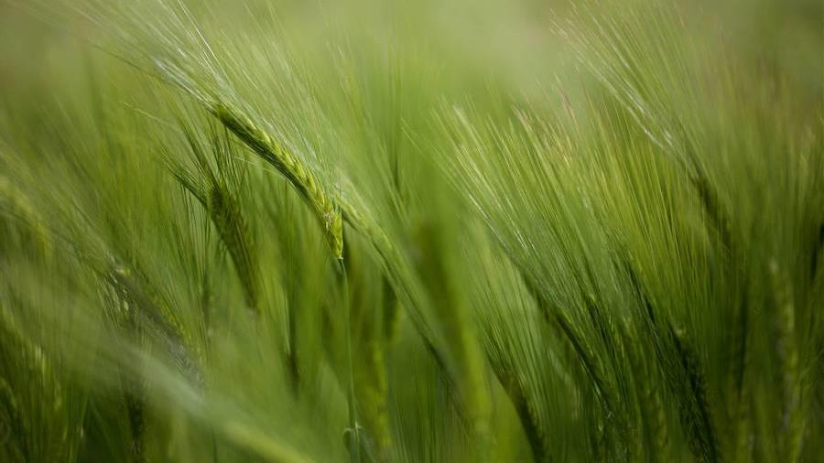
Introduction
Name: Nasrin Akter Ringkey
ID: 21080846
Notes:
1

Slide 2
Project Title
Comparative Analysis of Machine Learning Models for Diabetes Prediction Using Feature Engineering and Hyperparameter Optimization
Notes:
2

Slide 3
Abstract
Diabetes is a chronic metabolic disorder characterized by elevated blood sugar levels, which can lead to severe complications like cardiovascular disease, kidney failure, and blindness if not managed properly. Early detection is critical for effective treatment. This study evaluated four machine learning (ML) models Logistic Regression, K-Nearest Neighbors (KNN), Support Vector Machine (SVM), and Decision Tree for their effectiveness in predicting diabetes using the Pima Indians Diabetes Database.
The research methodology involved data preprocessing, feature engineering, model training, hyperparameter optimization, and performance evaluation. Data preprocessing addressed missing values, normalized features, and handled class imbalance using SMOTE. Feature engineering included generating polynomial features and selecting key features via SelectKBest with ANOVA F-value. Hyperparameter optimization was conducted using RandomizedSearchCV.
Model performance was assessed based on accuracy and AUC-ROC. KNN outperformed other models with an accuracy of 0.80 and an AUC of 0.86, demonstrating its robustness in handling complex data. Logistic Regression, with an accuracy of 0.76 and AUC of 0.84, was valued for its simplicity and transparency. SVM showed promise with an accuracy of 0.76 and AUC of 0.81 but required careful tuning. Decision Tree achieved 0.77 accuracy and 0.83 AUC, highlighting its strength in handling non-linear interactions.
This study underscores the importance of feature engineering and hyperparameter tuning in developing accurate predictive models for medical diagnostics. KNN's superior performance suggests it is well-suited for medical applications, while Logistic Regression remains useful for scenarios requiring interpretability. Future research should explore more diverse datasets and advanced techniques to further improve predictive modelling for diabetes, thereby enhancing patient outcomes and healthcare efficiency.
Notes:
3

Slide 4
Project Goal
AIM:
The aim of this study is to evaluate and compare the efficiency of various machine learning algorithms logistic regression, KNN, SVM, and decision trees in predicting diabetes based on clinical data, to determine the most effective model for clinical application.
Objectives:
To Acquire a deep understanding of diabetes, including its clinical indicators and impacts, to better inform the feature selection for machine learning models.
Prepare and preprocess the dataset to meet the requirements of each specific algorithm, ensuring optimal data quality for model training.
Train and optimize four different machine learning models: logistic regression, KNN, SVM, and decision trees, using the same dataset to ensure comparability.
Evaluate each model based on metrics such as accuracy, precision, recall, F1 score, and area under the ROC curve (AUC) to determine their effectiveness in predicting diabetes.
Conduct a comparative analysis of the results obtained from each model to identify the most accurate and efficient algorithm for diagnosing diabetes.
Identify potential improvements for each model and validate the best-performing model on a separate test set or through cross-validation.
Notes:
4

Slide 5
Research Questions
01. How do logistic regression, KNN, SVM, and decision trees compare in terms of their effectiveness at predicting diabetes from clinical data?
02. What impact do different clinical features have on the predictive accuracy of each model, and which features are most influential?
03. What are the optimal configurations for each model to achieve the highest accuracy in diabetes prediction?
04. Which model provides results that are most interpretable and potentially useful for clinical settings, facilitating early and accurate diabetes diagnosis?
Notes:
5

Slide 6
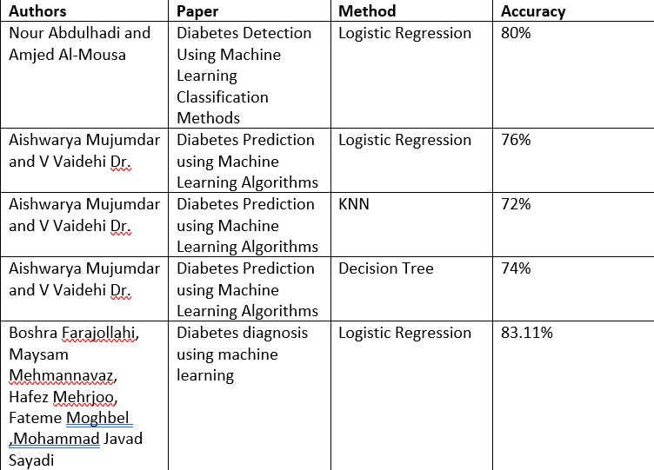
Literature Review
Notes:
6

Slide 7
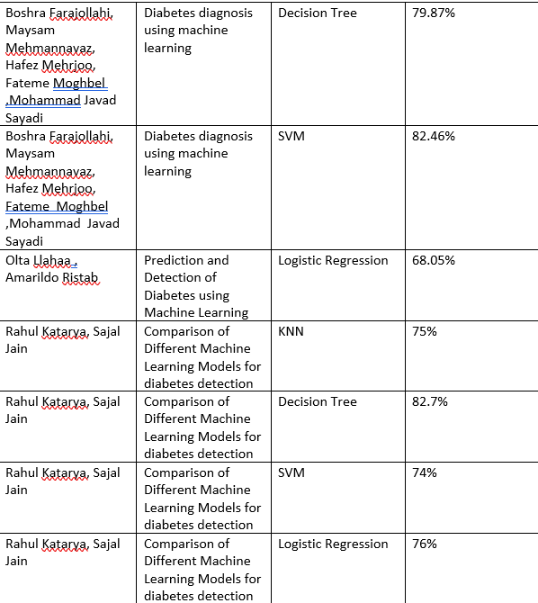
Literature Review
Notes:
7

Slide 8
Methodology
This study employed a rigorous methodology to ensure robust results in predicting diabetes using machine learning (ML) models based on the Pima Indians Diabetes Database from Kaggle. The dataset, sourced from the National Institute of Diabetes and Digestive and Kidney Diseases, includes clinical features like age, BMI, glucose levels, and insulin levels, with a target variable indicating diabetes status.
Data Preprocessing:
Given the absence of missing values, preprocessing focused on normalization (using min-max scaling) to standardize feature contributions, particularly for models sensitive to input scales, such as Logistic Regression and SVM. To address class imbalances between diabetes-positive and negative cases, SMOTE was used to generate synthetic samples for the minority class, improving model performance.
Feature Engineering:
Advanced techniques were applied, including the generation of polynomial features to capture non-linear relationships and the SelectKBest method, based on ANOVA F-value, for feature selection, reducing dimensionality and enhancing predictive accuracy.
Model Training and Optimization:
Four ML models—Logistic Regression, K-Nearest Neighbors (KNN), Support Vector Machines (SVM), and Decision Trees—were trained and optimized using RandomizedSearchCV. Regularization techniques in Logistic Regression and algorithm-specific tuning for the other models ensured optimal performance.
Model Evaluation and Comparative Analysis:
The models were evaluated on accuracy, precision, recall, F1 score, and AUC-ROC, with cross-validation ensuring robustness. A comparative analysis was conducted to identify the most effective model, considering interpretability and computational efficiency, ensuring practical applicability in clinical settings.
Notes:
8

Slide 9
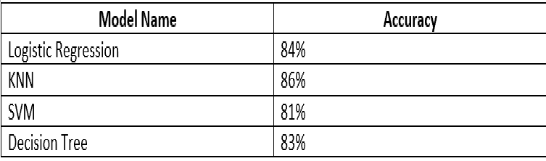
Result
Notes:
9

Slide 10
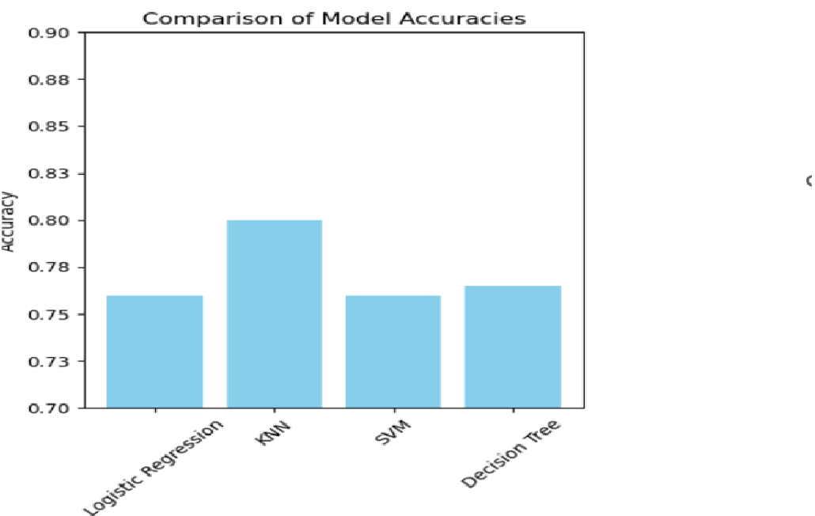
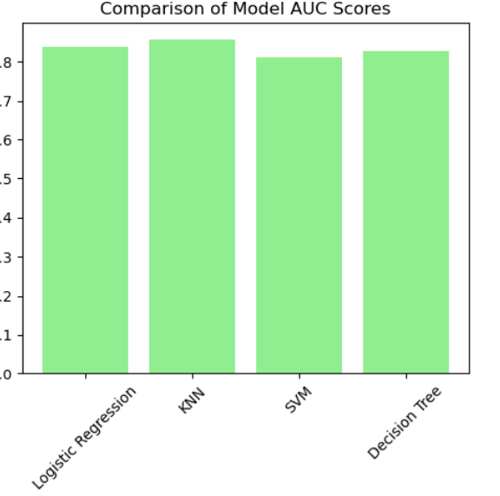

About us
Result
At Contoso, we empower farming communities to foster collaborative thinking to further drive workplace innovation. By closing the loop and leveraging ethical farming methods, we help businesses grow organically and nurture a consumer first mindset.
20XX
Pitch deck
10
Notes:
10

Slide 11
Conclusion
This study evaluated and compared four machine learning models Logistic Regression, K-Nearest Neighbors (KNN), Support Vector Machine (SVM), and Decision Tree for predicting diabetes using clinical data. The results indicate that KNN was the most effective, achieving the highest accuracy (0.80) and AUC score (0.86). Logistic Regression, SVM, and Decision Tree also performed well, each with distinct strengths and limitations.
Key Insights:
•Model Performance: KNN excelled in handling non-linear relationships and class imbalances, making it highly suitable for medical applications. Logistic Regression's simplicity and interpretability are valuable in clinical settings, while Decision Trees offer insights into feature importance. SVM, although slightly behind in performance, shows significant potential with proper parameter tuning.
•Feature Engineering and Data Preprocessing: Polynomial features and SMOTE significantly improved model performance, highlighting the importance of advanced feature engineering and preprocessing techniques.
•Hyperparameter Tuning: RandomizedSearchCV was crucial for optimizing model performance, underscoring the need for rigorous tuning to achieve optimal configurations.
Implications for Practice: The findings support integrating machine learning models, particularly KNN, into clinical practice for diabetes prediction. These models facilitate early diagnosis and personalized treatment plans. Continuous evaluation and updating with new data are essential to maintain accuracy and reliability.
Notes:
11

Slide 12
Thank You
Notes:
12

